Slide 1
Guided Capstone Project
Brad Painting

Slide 2

Problem Identification
Big Mountain Resort has installed an extra chairlift
Increases operating costs by $1,540,000
Already charging a premium above market average
What can Big Mountain Resort reasonably charge without driving away customers?

Slide 3
Key Findings / Recommendations
GOAL: Predict adult weekend ticket price
Findings
Adult weekday ticket price is #1 predictor of weekend price
“Days open last year” is the 3rd most important variable
Recommendations
Distribute premium across weekday and weekend tickets
Consider more snow-making machines or other strategies to prevent closings

Slide 4
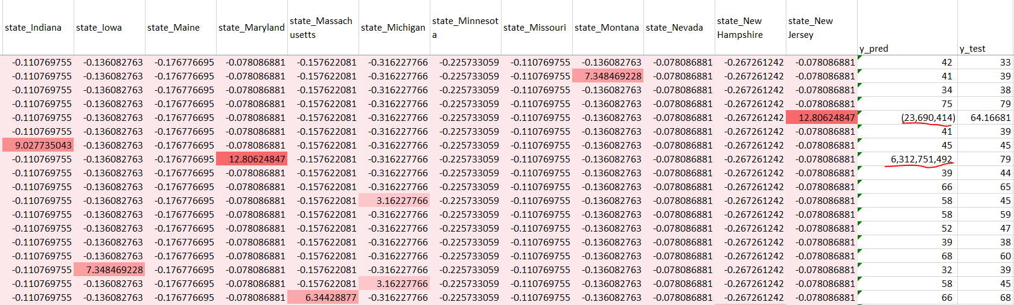
Model 1 Results
Normalized variables for State produce anomalous results
Do not use State as predictor

Slide 5
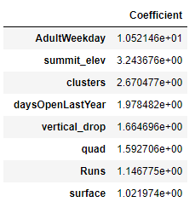
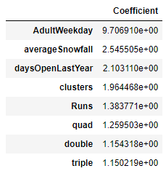


Models 2 and 3: Comparison
Model 2
Model 3
States dropped
States, summit elevation dropped

Slide 6
Summary and Conclusion
Cleaning and Pre-processing
Eliminated outliers and highly collinear variables
Normalized features (StandardScalar)
Modeling
Some states are too sparse and produce anomalies (Maryland, New Jersey)
Model 2 and 3 are satisfactory; I recommend Model 2.
I suggest running model on Weekday price to understand best way to distribute premium.

